Slide 1
Project Presentation of IOHE(22CS422)
NEXTSTEP-DREAM WEDDING DESTINATION PLATFORM
Abhishek Duggal:2210991163
Aaryaman Jindal:2210991119
Aaryan Kumar Goyal: 2210991120
Gauri Gupta :2210991574
Supervised By:-
Dr. Ajay Kumar
Department of Computer Science and Engineering,
Chitkara University, Punjab

Slide 2
Introduction
Background
Destination wedding planning involves multiple tasks (venues, vendors, bookings, coordination)
Process is time-consuming and complex
Use of multiple platforms/manual methods causes confusion
Leads to inefficiency, poor coordination, and stress
Need for a centralized platform to simplify and streamline planning
Problem Statement
Lack of integration between services (venues, vendors, scheduling) creates management issues Existing solutions do not offer a complete all-in-one platform Results in inefficient planning and poor requirement management Proposed system enables browsing, booking, and planning in one place Also supports planners and vendors with structured management tools
2

Slide 3
Software and Hardware Requirement Specification
Methods
The project is developed using an iterative approach where features are implemented step by step and improved based on testing.
Programming/Working Environment
Programming Language: JavaScript (React for frontend, Node.js for backend)
Database: MongoDB (NoSQL database)
Communication: WebSocket (for chat functionality)Email/SMS
Integration: Twilio (for SMS) and Node mailer (for email notifications)

Slide 4
Project Overview
:
This project is a web-based destination wedding planning platform that connects users, planners, vendors, and admins in one system.
Roles
User
Planner
Vendor
Admin

Slide 5
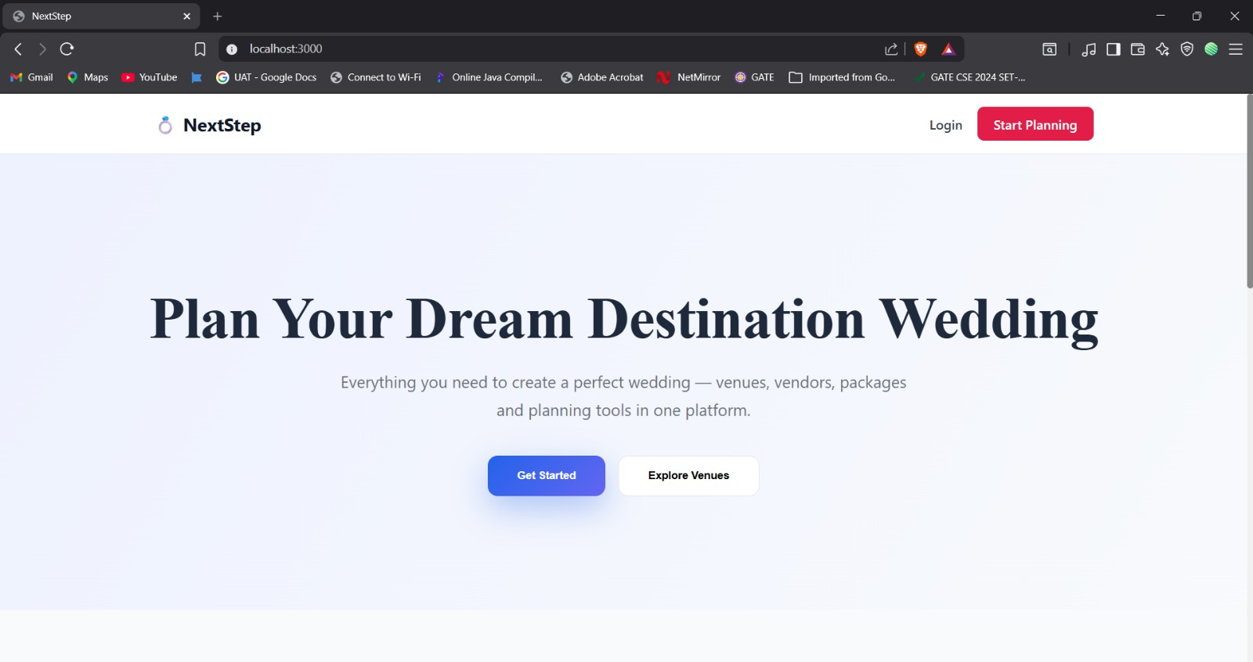
Project Snapshots

Slide 6
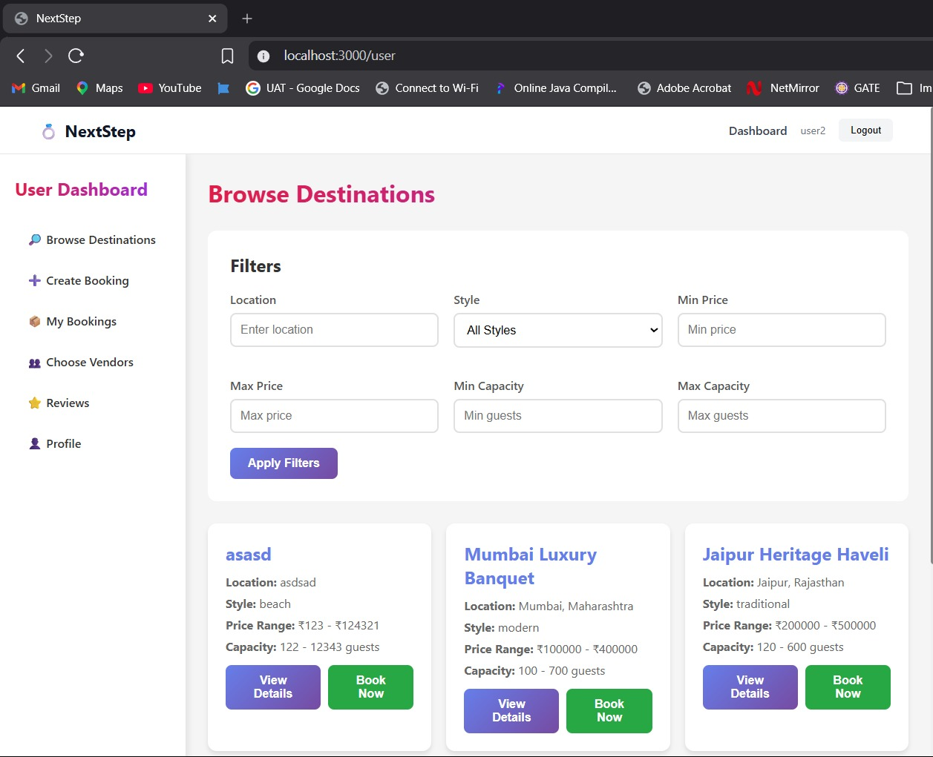

Slide 7
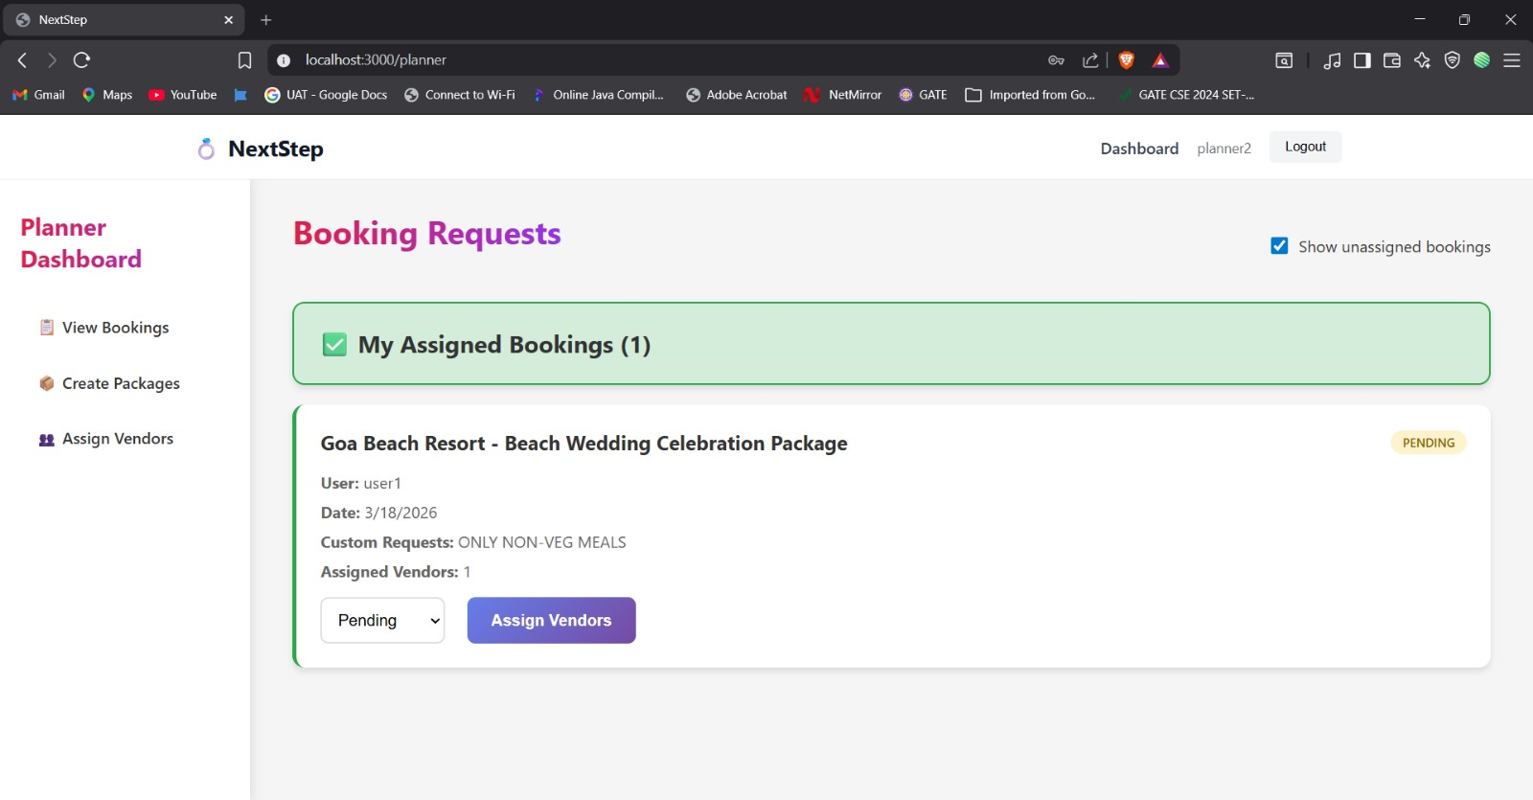

Slide 8
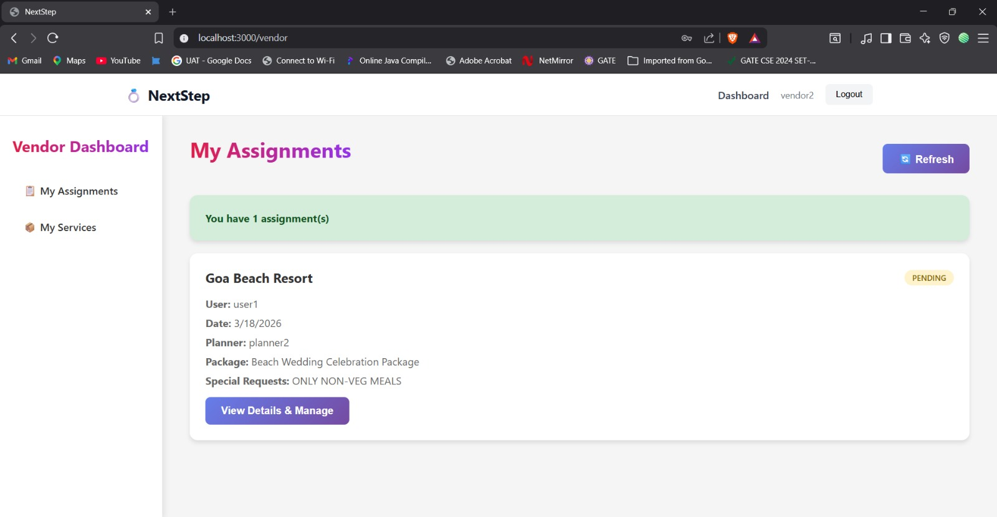

Slide 9
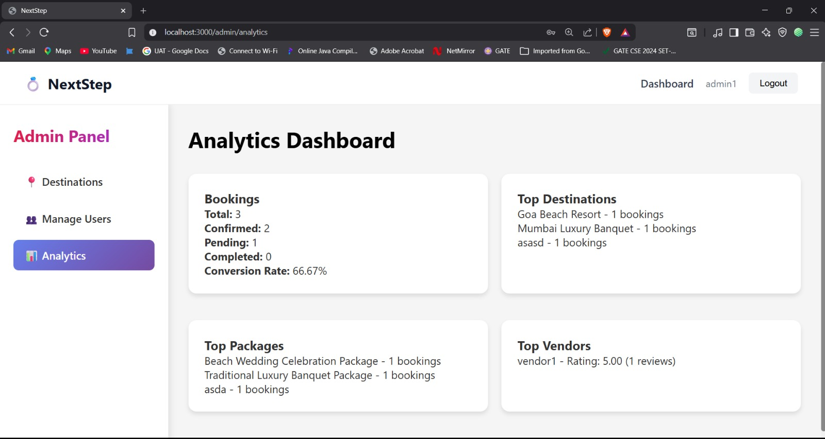

Slide 10
TECHNOLOGIES AND TOOLS
MERN Stack:
MongoDB: Scalable data management and storage in a NoSQL database.
A web application framework for creating reliable backend services is called Express.js.
React is a JavaScript package designed for creating interactive and dynamic user interfaces.
Node.js is a server-side development environment for JavaScript.
Extra Technology
Node mailer - Email notification system. Socket.io – used for real time communication b/w user and admin

Slide 11
Future Scope
AI integration for personalized recommendations (venues, vendors, themes)
Secure online payments via Stripe/Razorpay
Real-time chat for better coordination between users, planners, and vendors
Multi-language support for wider accessibility
Mobile app development for anytime, anywhere access

Slide 12
Conclusion
The development and implementation of the NextStep destination wedding planning system provides an efficient solution for managing wedding planning activities in a structured and organized way.
By integrating various features such as venue browsing, booking management, and dashboards for planners, vendors, and admin, the system reduces manual effort and simplifies the overall planning process.
Overall, the NextStep system provides a reliable and user-friendly solution that improves the wedding planning experience and can be further enhanced with advanced technologies.

Slide 13
Key Outcomes
1. Improved Efficiency: The system automates the process of searching, booking, and managing wedding services, which reduces manual work and saves time for both users and planners.
2. Enhanced User Experience: Users get a simple and easy-to-use interface where they can explore options, compare venues, and make bookings without confusion. The platform ensures smooth navigation and better interaction.
3. Better Management and Coordination: Planners and vendors can manage their tasks effectively through dedicated dashboards, which improves communication and coordination between all stakeholders.

Slide 14
Bibliography/References
https://www.mongodb.com
https://reactjs.org
https://nodejs.org
https://www.twilio.com/docs

Slide 15
Thank You
15

